Slide 1

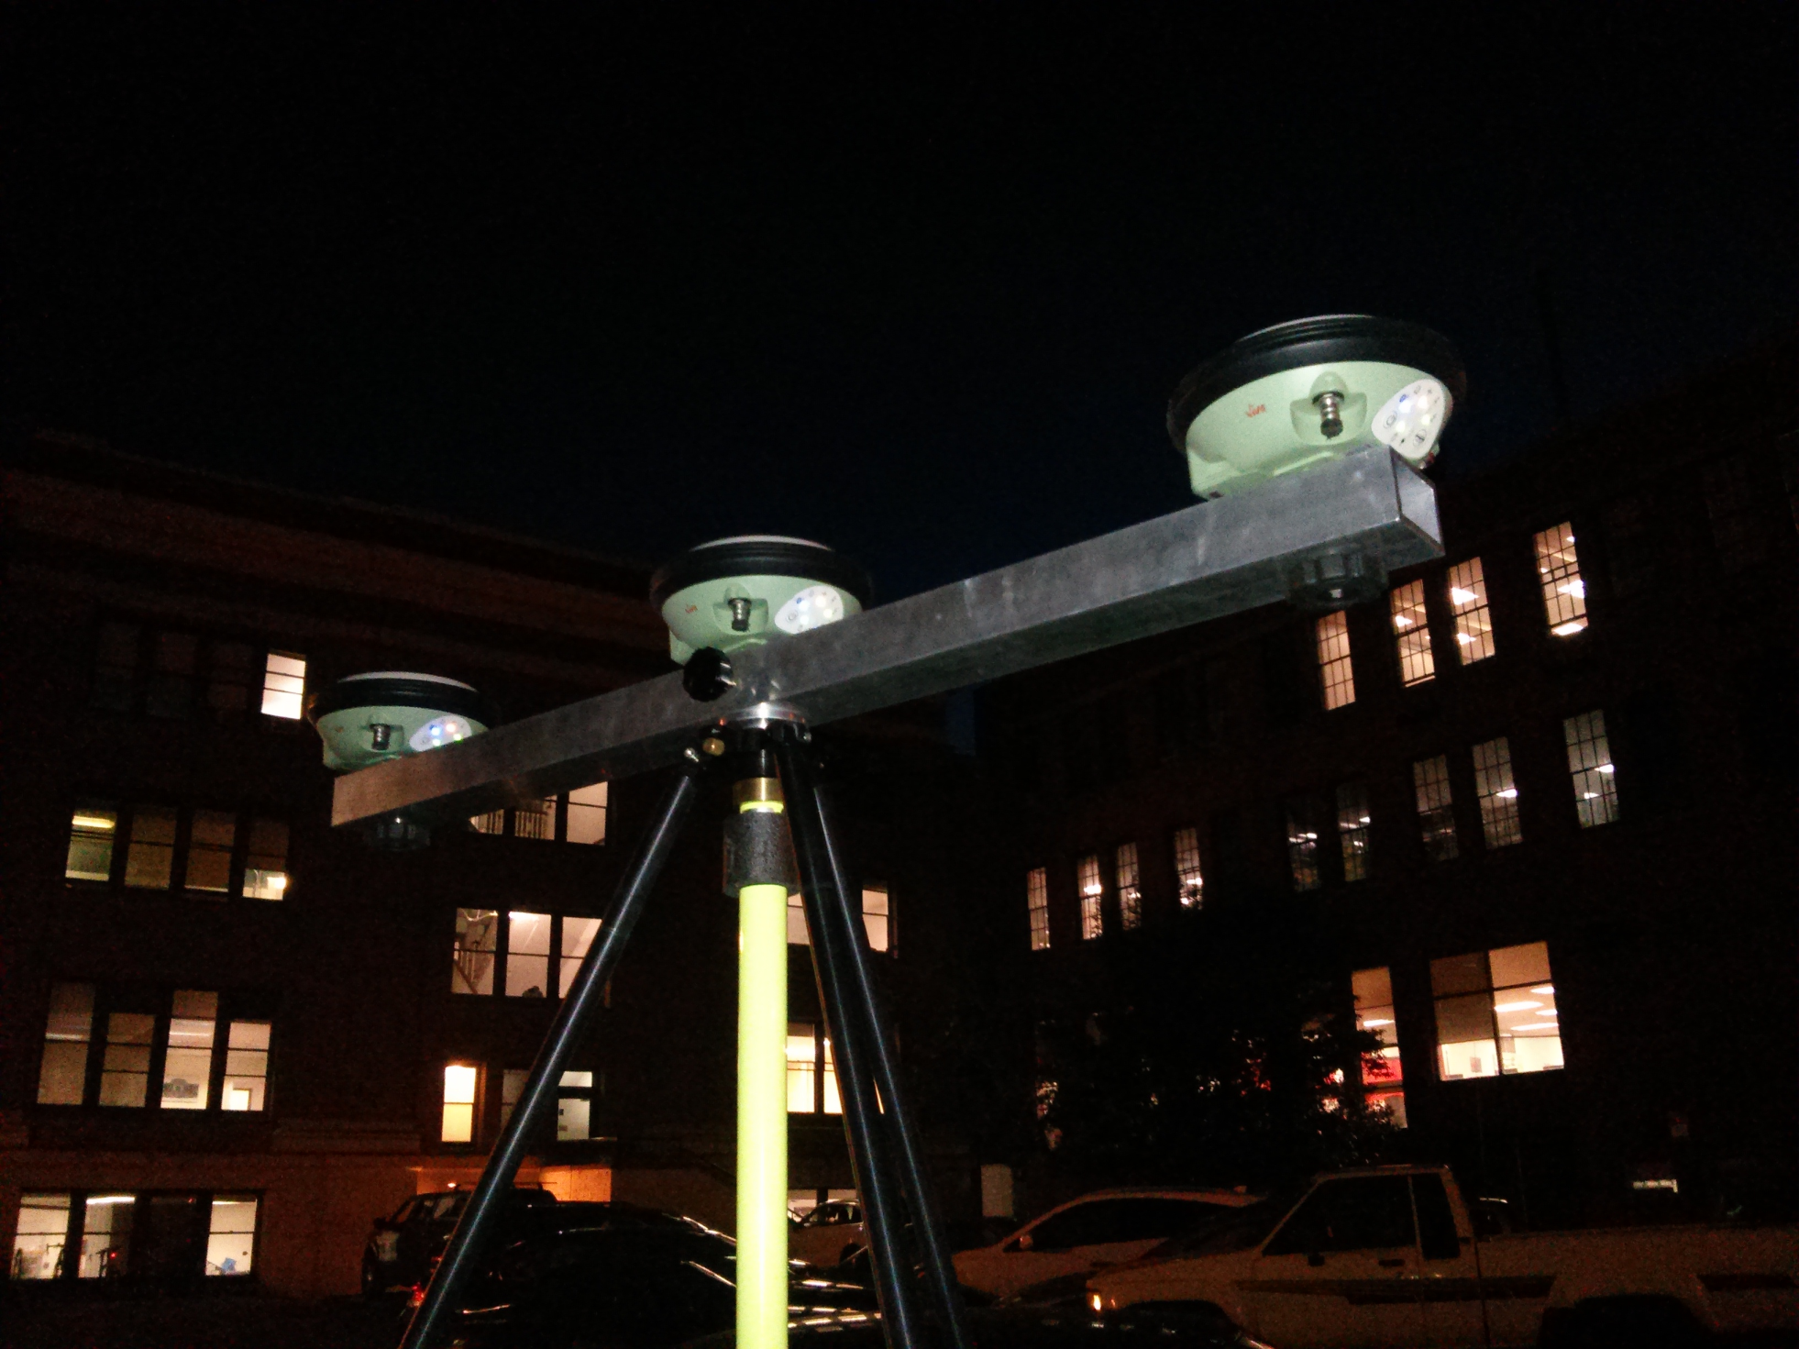
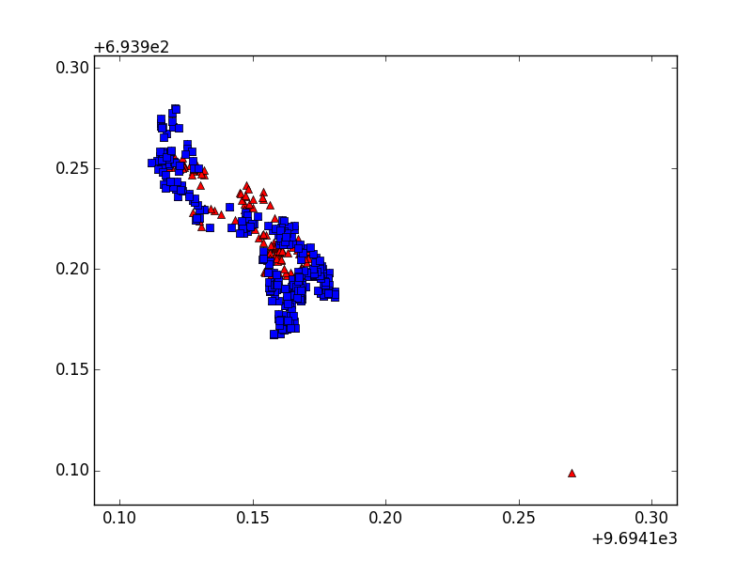
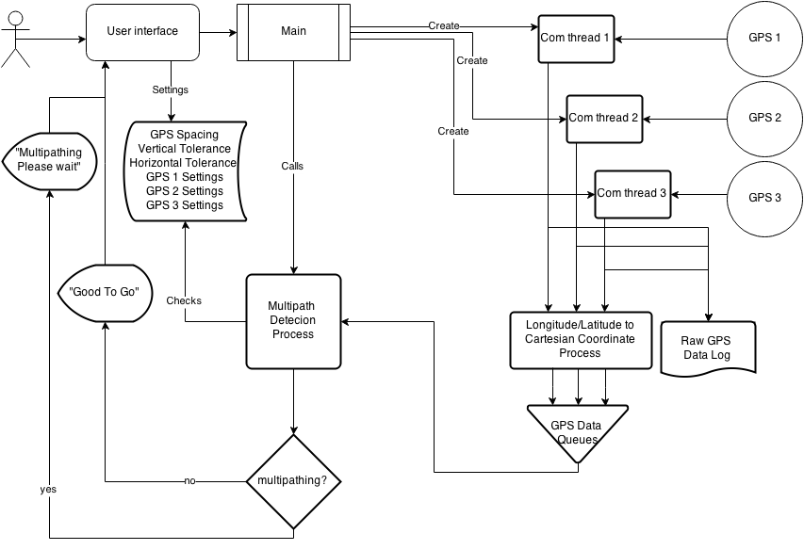
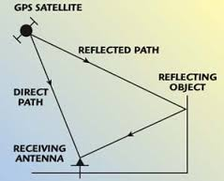
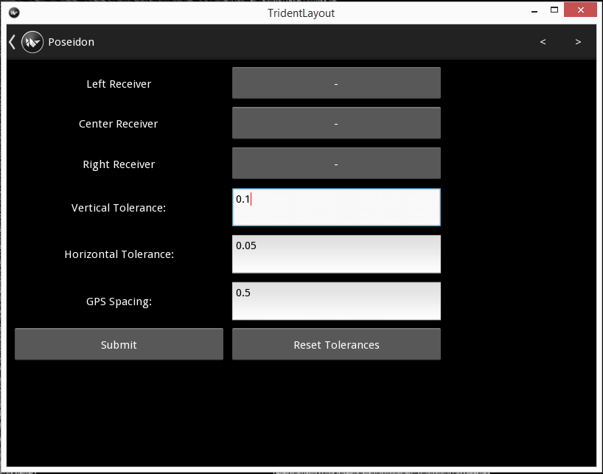
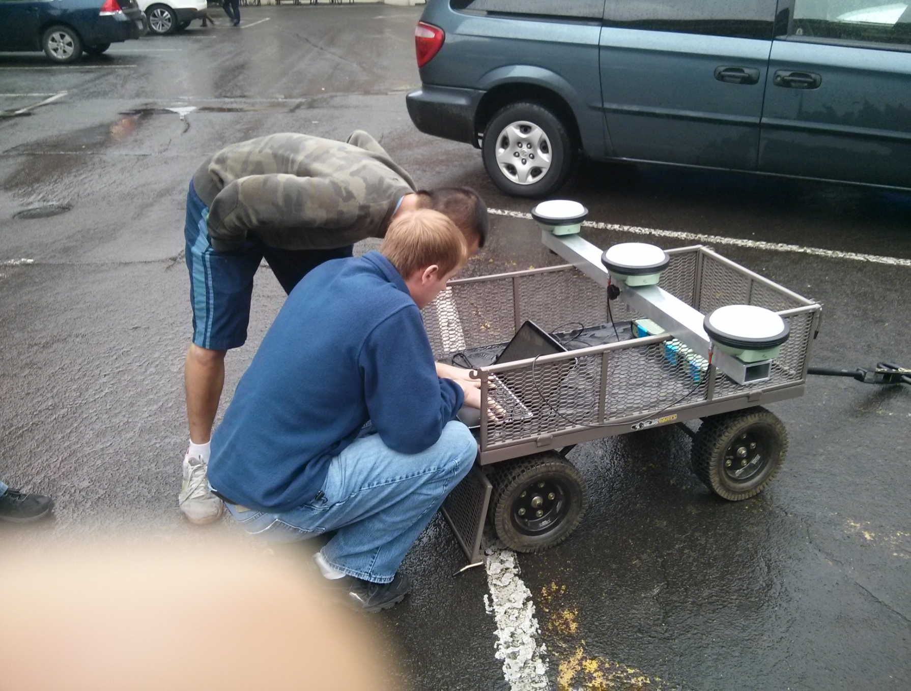
Oregon State University, College of Engineering
Trident GPS System
Solving Multipathing three GPSs at a time
Background
Surveyors work on the most precise level they are capable of. They use survey grade GPS receivers to receive data from active satellites in view. The common accuracy level is centimeters. A significant problem in quality of collected data occurs when obstructions, for example buildings or trees, nearby or overhead obstruct the line of site between the satellite and the GPS receiver.
These obstructions create potential for signal reflection, causing the GPS receiver to obtain an erroneous location. This phenomenon is termed multipathing by surveyors. This is a huge setback to surveyors because they set up their equipment, survey for hours on end, then process the data and recheck the position the next day. If multipathing occurs, they will need to recollect data.
Description
Instead of one GPS receiver, we use three. One main receiver and two to cross check the main. Oriented linearly with the main receiver in the middle.
We wrote a program to connect to all three receivers, and collect data from all three. Checks for multipathing and notifies surveyors of system status via a graphical user interface.
Results
Preliminary field testing shows that our program rules out several instances of multipathing as shown in Figure 4, which was logged under a tree with about 50% visibility
Bullet
Bullet
Figure 6. Trident GPS system, transmitting via Bluetooth to laptop
Contact Info
Client:
Dr. Dan Gillins Ph.D., P.L.S.
Assistant Professor of Geomatics
School of Civil & Construction Engineering
Oregon State University
Dan.Gillins@oregonstate.edu
Team Members:
Albert Le leal@onid.oregonstate.edu
Nathan Christopher
Christon@onid.oregonstate.edu
Daniel Lin
Lintzu@onid.oregonstate.edu
Figure 4. Unanalyzed Data (Red) overlaid by analyzed Data (Blue)
Figure 3. Trident Software Flow Diagram
The programming language we used was Python for speed and simplicity. Incorporating the Kivy framework for the GUI.
The multipathing algorithm tests for multipathing by:
single dot product calculation
average dot product calculation
linear tolerance check
outlier check
linear altitude tolerance check
Figure 1. GPS signal reflects off of obstructions causing Multipathing
Figure 5. Trident Software Settings menu
Figure 2. Initial testing of GPS connection and parsing via USB

